Slide 1
Centripetal Force and Gravitation Example Problems

Slide 2
Uniform Circular Motion
An object undergoes uniform circular motion when the object moves in a circular path at constant speed.

Slide 3
Uniform Circular Motion
The velocity vector for the object is tangent to the circular path at each point around the circle.

Slide 4
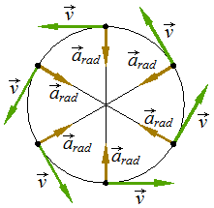
Uniform Circular Motion
Since the direction of the velocity changes, the object has acceleration. The acceleration vector is directed along a radius toward the center of the circle. “Directed toward the center” is called “centripetal” in physics. The acceleration of the object is the centripetal acceleration.

Slide 5
Uniform Circular Motion
Since the acceleration is perpendicular to the velocity, there is no component of acceleration along the line of velocity. With no component along the line of velocity, the acceleration cannot change the speed. The centripetal acceleration only changes the direction of the object.

Slide 6
Uniform Circular Motion
Since the acceleration is not in the direction of or against velocity, then it neither speeds up nor slows down (changes) speed.

Slide 7
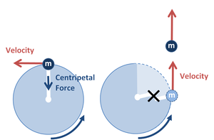
Uniform Circular Motion
According to Newton’s second law, if there is acceleration, there must be a NET force on the object. The NET force on an object must
be in the same direction as the acceleration.
The NET force on an object moving with uniform circular motion is directed toward the center of the circle, and is called the “centripetal force.”

Slide 8
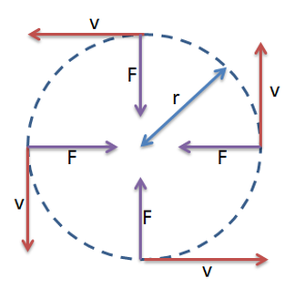
Uniform Circular Motion
For uniform circular motion, the speed of the object, the acceleration, and the NET force will have the same sizes at ALL TIMES.

Slide 9
Uniform Circular Motion
The centripetal force keeps the object moving in a circle. If the centripetal force is removed the object will move in a straight line, tangent to the circle at the point where the object was when the force was removed.

Slide 10
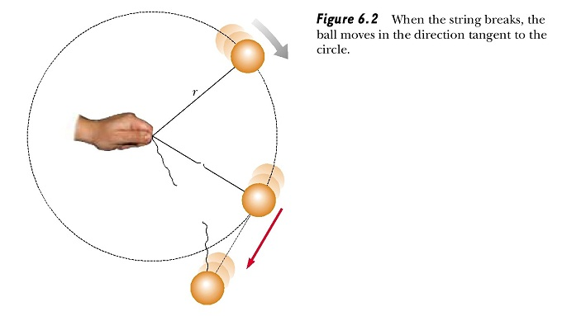
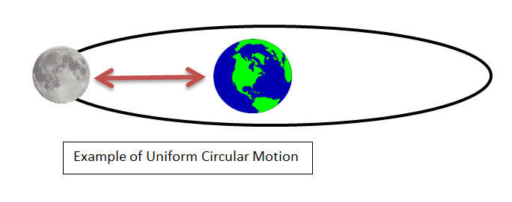
Uniform Circular Motion
Examples of uniform circular motion:
swinging ball on the end of a string
a car rounding a circular curve at constant speed
the Ferris wheel turning at constant speed
a satellite moving in a circular orbit around a planet

Slide 11
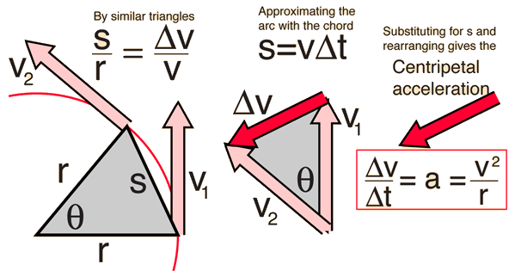
Uniform Circular Motion
The centripetal acceleration of an object depends upon two factors:
1. the speed of the object
2. the radius of the circular path

Slide 12
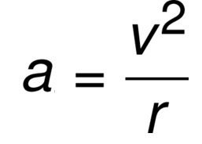
Uniform Circular Motion
The centripetal acceleration of an object depends upon two factors:
1. the speed of the object
2. the radius of the circular path
The faster the object moves, the larger is its acceleration.
A smaller acceleration is needed for an object to move in a larger circle.
In math terms, the acceleration of the object is directly proportional to the square of the speed and inversely proportional to the radius of the circle.

Slide 13
Uniform Circular Motion
The centripetal acceleration of an object depends upon two factors:
1. the speed of the object
2. the radius of the circular path
Relationships:
If the speed increases (doubles), the acceleration increases (by four times b/c of v² piece).
If the distance increases (doubles), the acceleration decreases (by half b/c of the r piece of the equation)

Slide 14
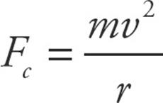
Uniform Circular Motion
F_{c} – centripetal force in newtons
m – mass of object in kilograms
v – speed in meters/second²
r – radius of the circle in meters
According to Newton’s second law, NET F = ma, the NET force on the object must be ma_{c}. The NET force on an object with uniform circular motion is the centripetal force, F_{c}. Since a_{c} = v²/r, then

Slide 15
Uniform Circular Motion
Twice as much force is needed to move an object that is twice as massive.
To double the speed, the force must be 4 times larger.
Half as much force is needed to move the object in a circle that is twice as large.
According to Newton’s second law, NET F = ma, the NET force on the object must be ma_{c}. The NET force on an object with uniform circular motion is the centripetal force, F_{c}. Since a_{c} = v²/r, then

Slide 16
Uniform Circular Motion
For the examples given earlier:
The tension in the string provides the centripetal force for the ball.
Friction provided the centripetal force for the car.
The wheel beams and struts provided the centripetal for the seats.
Gravity provided the centripetal force for the satellite.

Slide 17
Uniform Circular Motion
The two equations above apply to an object moving in a circular path at ANY point in its path.
IF the object has uniform circular motion, THEN the equations produce the same values at ALL points.
IF the object has nonuniform circular motion, THEN the equations produce different values at different points because the speed will NOT be the same at all points.

Slide 18
Non-uniform circular motion

Slide 19
1) A 0.8-kg ball swings in a horizontal circle at the end of a 1.2 m long rope. The ball swings at a constant 3 m/s.
a) What is the centripetal force on the ball?
F = ma , and since a= $\frac{v2}{r}$
F= $\frac{mv2}{r}$

Slide 20
1) A 0.8-kg ball swings in a horizontal circle at the end of a 1.2 m long rope. The ball swings at a constant 3 m/s.
a) What is the centripetal force on the ball?
F = ma , and since a= $\frac{v2}{r}$
F= $\frac{mv2}{r}$ = $\frac{\left(0.8 kg\right)\left(\frac{3m}{s}\right)2}{1.2m}$ = 6N

Slide 21
1) A 0.8-kg ball swings in a horizontal circle at the end of a 1.2 m long rope. The ball swings at a constant 3 m/s.
(b) What is the tension in the rope?
The tension in the rope is the centripetal force on the ball!

Slide 22
2) A 2-kg object is on a horizontal rotating platform. The object is 1.5 m from the axis of rotation of the platform. The platform completes 15 revolutions in 30 seconds.
a. What is the speed of the object?
You need the arc length formula to solve: radian measure = arc length / radius or ΘΔ = $\frac{ΔS}{r}$
15 rev/30 s = 0.5 rev/s
0.5 rev = π radians
π = $\frac{ΔS}{1.5m}$ , so $ΔS$ = 4.71m. This distance is achieved in one second. So, the speed is 4.71 m/s

Slide 23
2) A 2-kg object is on a horizontal rotating platform. The object is 1.5 m from the axis of rotation of the platform. The platform completes 15 revolutions in 30 seconds.
a. What is the speed of the object?
Or
You could use circumference of a circle:
2 πr (15 rev./30 s)
=2 π(1.5m) * (0.5 rev/s) = 4.71 m/s

Slide 24
2) A 2-kg object is on a horizontal rotating platform. The object is 1.5 m from the axis of rotation of the platform. The platform completes 15 revolutions in 30 seconds.
a. What is the speed of the object?
Or for a whole revolution:
v = $\frac{ΔX}{t}$ = $\frac{\text{2}\text{π}\text{r}}{t}=$ $\frac{\text{2}\text{π}\text{r}}{t}$
= $\frac{\text{2} \text{π}\text{(1.5}\text{m}\text{)}}{2s}$ = 4.71 m/s

Slide 25
2) A 2-kg object is on a horizontal rotating platform. The object is 1.5 m from the axis of rotation of the platform. The platform completes 15 revolutions in 30 seconds.
b. What is the centripetal acceleration of the object?
a= $\frac{v2}{r}$ = $\frac{(\frac{4.17m}{s})2}{1.5m}$ = 14.8 m/s²

Slide 26
2) A 2-kg object is on a horizontal rotating platform. The object is 1.5 m from the axis of rotation of the platform. The platform completes 15 revolutions in 30 seconds.
c. What is the centripetal force on the object?
F= $\frac{mv2}{r}$

Slide 27
2) A 2-kg object is on a horizontal rotating platform. The object is 1.5 m from the axis of rotation of the platform. The platform completes 15 revolutions in 30 seconds.
c. What is the centripetal force on the object?
F= $\frac{mv2}{r}$ = $\frac{(2kg)(\frac{4.17m}{s})2}{1.5m}$ = 29.6 N

Slide 28
3. I swing a 5-kg object in a vertical circle of radius 1.5 m. The tension in the rope when the object is at the top of the circle is 11 N. The speed of the object is 8.8 m/s when the object is at the bottom of the circle.
a. What is the speed of the object at the top of the circle?

