Slide 1
Electrostatics and Electric Fields

Slide 2
Electrostatics and Electric Fields
An object can have a positive charge, a negative charge, or no charge. Charge is a property due to different numbers of electrons and protons in an object.
An object is electrically neutral when the numbers of electrons and protons are equal. An object becomes charged when the object gains or loses electrons.
Positive charge – the object has lost electrons: number of electrons < number of protons
Negative charge – the object has gained electrons: number of electrons > number of protons

Slide 3
Electrostatics and Electric Fields
The size of the charge on the object is due to the amount of difference in the numbers of electrons and protons.
Each electron has a charge of
-1.6 X 10⁻¹⁹ coulomb.
Each proton has a charge of
+1.6 X 10⁻¹⁹ coulomb.
The size of the charge on an object = ± 1.6 X 10⁻¹⁹ C/particle • excess number of particles.
The unit of electric charge is the coulomb. A coulomb of charge is the amount of charge on 6.25 X 10¹⁸ electrons (or protons). The SI symbol for the coulomb is C.

Slide 4
Electrostatics and Electric Fields
Since charge comes from electrons and protons, charge is a conservative property. You can neither create nor destroy protons and electrons; you can only transfer them from one object to another. For one object to gain electrons another object must lose an equal number of electrons.
If one object’s charge changes from +1 to 0 then some other object must change charge by +1.

Slide 5
Electrostatics and Electric Fields
When objects of different charge touch, the total charge spreads equally over both objects.
If object A has a charge of +4 and object B has a charge of –2 and these objects touch, the total change is +2. This charge will be divided equally over the two objects while the two objects are in contact. If the two objects are separated, each object will get half of the total charge. If separated, each object would have a charge of +1.

Slide 6
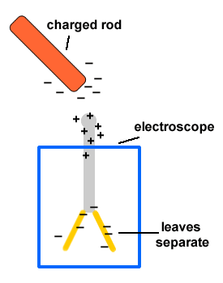
Electrostatics and Electric Fields
If a negatively-charged object is brought near a neutral conductor, the electrons on the surface of the neutral conductor will move away from the charged object. This produces an unequal distribution of charge on the neutral object.
This makes the end of the neutral object closest to the charged object positive (local electrons have been repelled) and the end of the neutral object farthest from the charged object negative (electrons from the other end moved here).

Slide 7
Electrostatics and Electric Fields
When the charged object is removed, the electrons will move back so the charge is equally distributed again. This temporary condition of unevenly distributed charge in a neutral object due to the presence of a charged object is called an induced charge.

Slide 8
Electrostatics and Electric Fields
The charge on an object resides on the outside surface of the object.
Charged objects apply a force on each other. This force is referred to as the electrostatic force, the electric force, or the Coulomb force. Like charges repel and opposite charges attract. This force is described by Coulomb’s Law: The electric force between two charged objects is directly proportional to the product of the magnitudes of the charges and inversely proportional to the square of the distance between the objects.
The equation for Coulomb’s law is:
F – electric force on one of the charged objects in newtons
K – Coulomb’s law constant or electric constant or electrostatic constant = 9 X 10⁹
q₁ – size of the charge on one of the objects in coulombs
q₂ – size of the charge on the other object in coulombs
r – distance between the two objects in meters

Slide 9
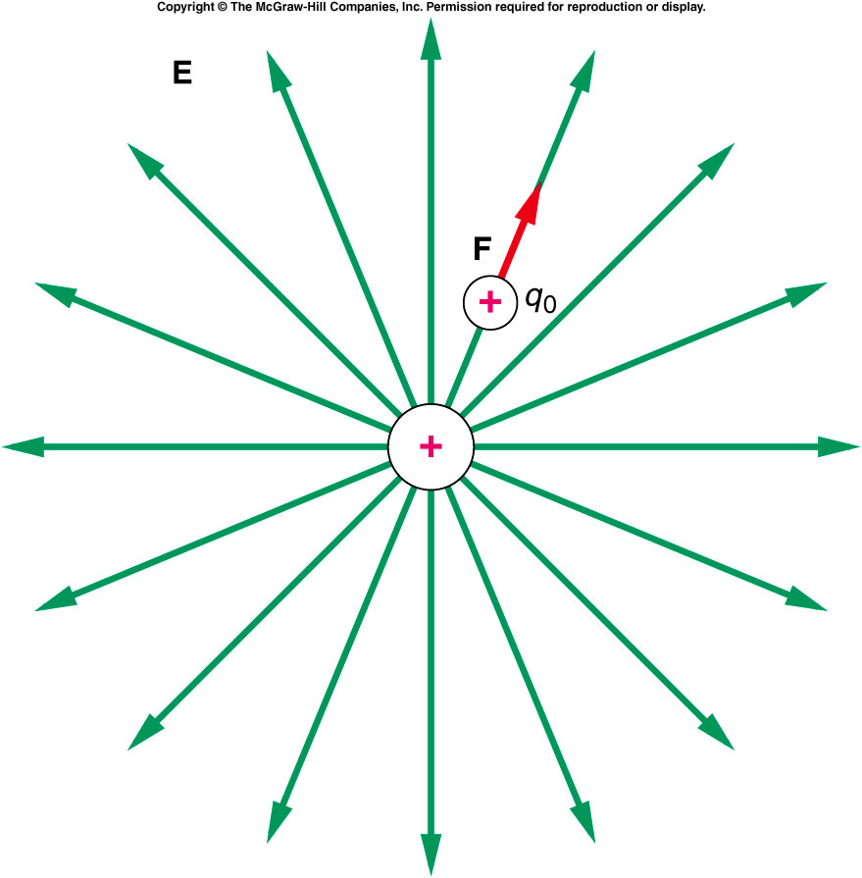
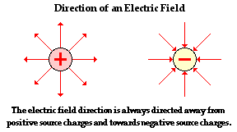
Electrostatics and Electric Fields
A charged object produces an electric field around it. An electric field is a region of space in which a charged object will “feel” an electric force. This means a test charge placed in the field will feel a force. A test charge is a small, positive charge. The test charge is considered so small that the test charge does not change the electric field.

Slide 10
Electrostatics and Electric Fields
We represent an electric field as lines of forces. These lines of force are shown as arrows. The arrows start from a positive change and point toward a negative charge. The arrow shows the direction of the force the test charge experiences. The lines of force in an electric field show the direction the field will push a positive charge placed at that location of the field.

Slide 11
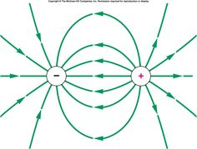
Electrostatics and Electric Fields
The lines of force extend outward from a positive charge and inward toward a negative charge. The lines are perpendicular to the surface of the object where they meet the object. The direction of the field is tangent to the line of force if the line is curved.

Slide 12
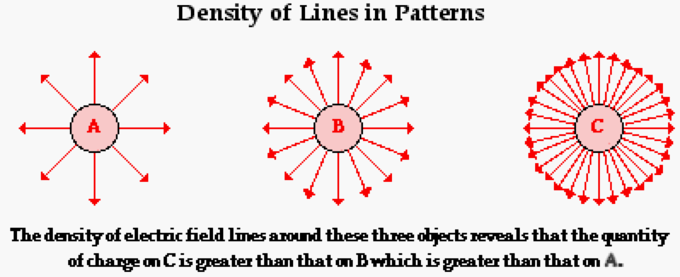
Electrostatics and Electric Fields
The density of lines of force is an indication of the strength of the electric field. Where the lines are closer together, the field is stronger. “Stronger” means the field will exert a larger force on a given charge.

Slide 13
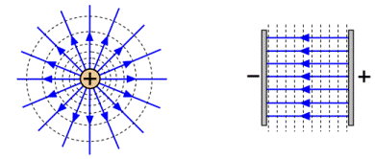
Electrostatics and Electric Fields
An electric field will be uniform if the lines of force are parallel. The field will be nonuniform if the lines are not parallel.
The strength of an electric field is due to the object that produces the field, not the object IN the field.
There are three ways to calculate the strength of an electric field:

Slide 14
Electrostatics and Electric Fields
E – electric field strength at a point in an electric field in newtons/coulomb
F – magnitude of the force the field exerts on the charge that is in the field in newtons
q – magnitude of the charge on the object that is in the field in coulombs
K – Coulomb’s law constant
= 9 X 10⁹
Q – magnitude of the charge on the object that produces the electric field in coulombs
r – distance the point in the field is from the object that produces the electric field in meters
V – electrical potential difference (voltage) between two points in a uniform electric field in volts
d – distance between two points in a uniform electric field in meters

Slide 15
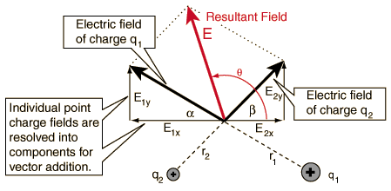
Electrostatics and Electric Fields
Equation I applies to any electric field.
Equation II applies to the electric field around a single point charge.
Equation III applies to a uniform electric field such as between two charged, parallel plates
If there is more than one object producing a field, the field strength at any point is the vector sum of the field strengths of the individual objects.

Slide 16
Electrostatics and Electric Fields
In a uniform field, E will be the same at all points. That means a charge of q would feel the same force at any location in the field.
In a nonuniform field, E will have different values at different points. There may be some points that have the same E but not all points will have the same E.
The direction of an electric field is the direction the field pushes a POSITIVE charge. The field will push a negative charge in a direction opposite the direction of the field.

Slide 17
Electrostatics and Electric Fields
Uniform Electric Fields
A uniform electric field is an electric field in which a charged object will experience the same size and direction force at any point in the field. We can produce an almost uniform electric field between two large parallel plates if the plates are given equal but opposite charges. We represent such a field below:
The field lines of force are parallel to each other. The lines of force show the direction the field will push a positive charge. This means the arrows are drawn from the positively charged plate to the negatively charged plate.

Slide 18
Electrostatics and Electric Fields (Uniform)
The force on the charged objects is the same size and direction at all points. The direction is parallel to the lines of force. If a positive charge is placed close to the positive plate, the positive plate will repel the charge and the negative charge will attract the charge.
The push of the positive plate will be larger than the pull of the negative plate. The charge will move toward the negative plate. This movement reduces the push of the positive plate and increases the pull of the negative plate. These two changes exactly offset each other so the total force on the particle remains the same.

Slide 19
Electrostatics and Electric Fields (Uniform)
A positive charge will be pushed in the direction in which the arrows point.
A negative charge will be pushed in the opposite direction to which the arrows point.
In the field shown above, a positive charge will be pushed right and a negative charge will be pushed left.
The electric field strength is given by the general equation for electric field strength:
The value of E is the same at all locations in the field.

Slide 20
Electrostatics and Electric Fields (Uniform)
A positive charge will be pushed in the direction in which the arrows point.
A negative charge will be pushed in the opposite direction to which the arrows point.
In the field shown above, a positive charge will be pushed right and a negative charge will be pushed left.
The electric field strength is given by the general equation for electric field strength:
The value of E is the same at all locations in the field.

Slide 21
Electrostatics and Electric Fields (Uniform)
If a charged particle is placed in the field and is free to move, the field will exert a force on the charged particle and cause it to move. Since the field exerts a force on a moving object, the field does work in moving the charged particle.
Work done ON an object is converted into energy that is gained by the object that is moving. In this case the charged object will gain kinetic energy and move faster and faster as long as the field pushes on the object. Energy cannot be created nor destroyed.

Slide 22
Electrostatics and Electric Fields
The kinetic energy gain of the charged particle comes from a loss of electrical potential energy. As the particle moves, the charged particle loses electrical potential and gains kinetic energy.
The work done by the electric field on a moving charged particle is given by:
W – work done on the charged object by the electric field in joules
q – charge on the object that the field moves in coulombs
E – electric field strength in newtons/coulomb
d – distance the object moves while in the field in meters

Slide 23
Electrostatics and Electric Fields
Since the moving charged object changes electrical potential energy, the two points between which the particle moves must be at different electrical potentials. Difference in electrical potential is voltage.
The equation above can be modified:
W – work done on the charged object by the electric field in joules
q – charge on the object that the field moves in coulombs
V – electrical potential difference between two points in the electric field in volts

Slide 24
Electrostatics and Electric Fields
The electric field strength of a uniform electric field can also be calculated by algebraically combining some equations to produce this equation:
V – electrical potential difference between two points in the electric field in volts
d – distance between the two points in meters
E – electric field strength in N/C or V/m

Slide 25
Electrostatics and Electric Fields
When a charged particle moves between two points in an electric field, the electric field does work on the particle. The work done by the field on the particle causes a change in the kinetic energy of the particle.
The work done is equal to the change in the kinetic energy of the particle.
W = ΔKE remember
KE = ½ mv²
If an electric field moves a charged particle from point A to point B then
W _{A → B} = KE_{B} - KE_{A}
If the particle was motionless at point A then W = KE_{B} and $W = ½ mv_{B}.$

Slide 26
Example Problems
1. What is the electric force on a Na ¹⁺ ion from an O ²⁻ ion when the ions are 2 X 10 ⁻¹⁰ m apart?

Slide 27
Example Problems
1. What is the electric force on a Na ¹⁺ ion from an O ²⁻ ion when the ions are 2 X 10 ⁻¹⁰ m apart?
F = $\frac{\text{kq}\text{1}\text{q}\text{2} }{r2}$
= $\frac{\text{(9.0}\text{x}\text{109 }\text{Nm}\text{2}\text{/}\text{C}\text{2}\text{)(+1.6 }\text{x}\text{ 10-19}\text{C}\text{)(2*-1.6}\text{x}\text{ 10−1}\text{9}\text{C})}{\text{(2 }\text{x}\text{ 10−1}\text{0}\text{m}\text{)2}}$
=

