Slide 1
Forces and Motion
Newton’s Laws of Motion

Slide 2
Newton’s Laws of Motion – Accelerated Motion Version
In 1667, Isaac Newton identified three laws of motion which are the basis of our study of mechanics which is often call Newtonian mechanics. “Mechanics” refers to the motion of objects larger than atoms moving at speeds much less than the speed of light far from large gravitational fields like that of stars.
Describing motion without referring to forces is called “kinematics.” That is what we have done so far. Newton’s laws tell the relationship between forces and motion. Describing motion using forces is called “dynamics.”

Slide 3
Newton’s First Law
– law of inertia – IF there is no NET force on an object THEN an object at rest will remain at rest and an object that is already moving will continue to move in a straight line at constant speed.

Slide 4
Newton’s First Law The Law of Inertia
IF there is no NET force (total force) on an object, THEN an object at rest will remain at rest
IF an object is moving, THEN it will continue to move in a straight line at constant speed until another force acts on it
definition of Constant Velocity, means acceleration is zero

Slide 5
Newton’s First Law
Moving at constant speed in a straight line is the definition of constant velocity. Constant velocity occurs when the acceleration of the object is zero. We can restate the first law: IF the NET force on an object is zero THEN the acceleration of the object is zero.
-

Slide 6
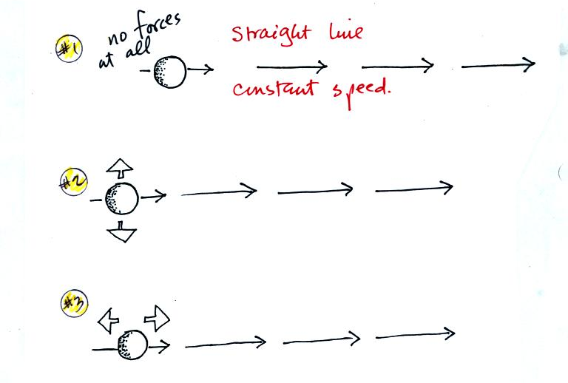
Newton’s First Law
IF the NET force on an object is zero THEN the object has two possible motions:
1. The object is and remains motionless.
2. The object is already moving and will continue to move in a straight line at constant speed.
-

Slide 7
Newton’s First Law
For an object to start moving, the NET force on the object is not zero.
For an object to stop moving, the NET force on the object is not zero.
IF an object accelerates THEN the NET force on the object is not zero.

Slide 8
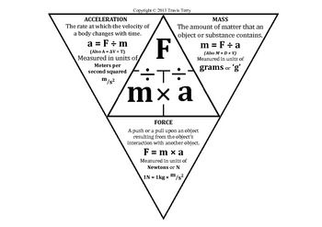
Newton’s 2nd Law
Newton’s Second Law – law of acceleration – The acceleration of an object is directly proportional to the NET force on the object and inversely proportional to the mass of the object.
F = ma
a = $\frac{Fnet}{m}$
a – the acceleration of the object in m/s²
F – NET force - the vector sum of all the forces on the object in newtons, N
m – mass of the object in kg

Slide 9
Newton’s 2nd Law
The acceleration of an object depends upon the combined effect of ALL the forces on the object.
Acceleration and NET force are vector quantities. They have direction. The direction of the acceleration is the same as the direction of the NET force. Mass is a scalar quantity.

Slide 10
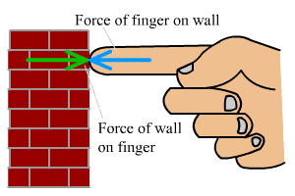
Newton’s 3rd Law
Another statement of Newton’s Third Law – law of action-reaction – For every action there is an equal but opposite reaction. We shall see what Newton meant by “action” and “reaction” later.
– law of paired forces – When object A applies a force on object B, object B will apply a force on object A that is equal in magnitude and opposite in direction.

Slide 11
Free Body Diagrams
A free-body diagram shows all the forces on an object. Each force is represented by an arrow. The length of the arrow shows the magnitude of the force and the arrow points in the direction in which the force acts. The tail of the arrow is connected to the system object and points AWAY from the object.

Slide 12
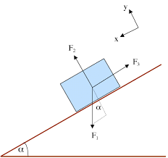
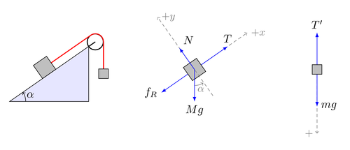
Free Body Diagrams
IF the object is on a surface THEN draw the X-axis parallel to the surface.
IF the object in NOT on a surface THEN draw the X-axis horizontal.
STEP 4: Determine which forces act on the object.
STEP 5: Draw and label the forces identified in step 3 acting on the system object you drew in step 2. The force vector is drawn with its tail on the system object and its arrow pointing away from the object.
STEP 1: Identify the system – the one object whose motion you want to examine.
STEP 2: Draw the system object as a point or a box with no other objects shown.
STEP 3: Draw X-Y axes and assign + and – directions for each axis.

Slide 13
Types of Forces
gravity - The force of gravity or weight vector always points toward the center of the earth.
normal force – The normal force vector always points away from the surface and is perpendicular to the surface.
NOTE WELL – The normal force is only straight upward if the surface is level, perpendicular to the force of gravity.

Slide 14
Types of Forces
friction – The friction vector is always parallel to the surface that produces the friction.
For sliding or kinetic friction the vector will point opposite the direction in which the object moves.
For static friction the vector will point opposite the direction in which the object would move if there were no static friction.

Slide 15
Types of Forces
spring force – The spring force is directed parallel to the spring.
compressed spring – The spring force is away from the spring.
stretched spring – The spring force is toward the spring.

Slide 16
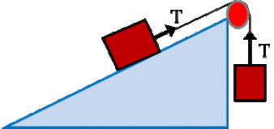
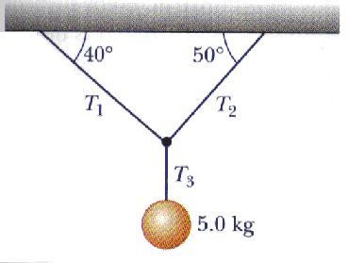
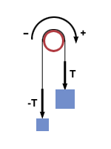
Types of Forces
tension – The tension force of a rope is directed along the line of the rope and away from the system object.
The tension must always be a pull.

Slide 17
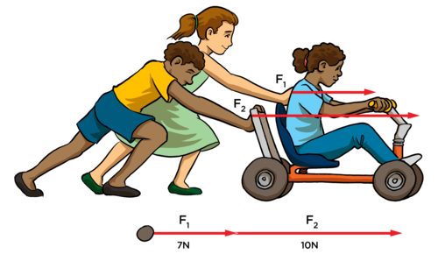
Types of Forces
contact force from solid object - The direction of this force is determined by the situation described in the problem.

Slide 18
How to calculate Forces
IF an object moves across a surface THEN
Σ X-components = NET force
Σ Y-components = zero
TO CALCULATE:
weight use W = mg or Σ Y-components = zero
friction use Σ X-components = NET force or $f= μN$
normal force use Σ Y-components = zero or $f= μN$
other individual contact force use
Σ X-components = NET force
Σ Y-components = zero
IF an object moves straight up or down THEN
Σ Y-components = NET force
Σ X-components = zero
TO CALCULATE:
weight use W = mg or Σ Y-components = NET force
vertical spring force use Σ Y-components = NET F
other individual contact force use
Σ Y-components = NET force
Σ X-components = zero

Slide 19
1. A single force of 1.5 N pulls a 3 kg object from rest across a surface.
(a) What is the acceleration of the object?

Slide 20
1. A single force of 1.5 N pulls a 3 kg object from rest across a surface.
(a) What is the acceleration of the object?
a = $\frac{Fnet}{m}$ = $\frac{1.5N}{3 kg}$

Slide 21
1. A single force of 1.5 N pulls a 3 kg object from rest across a surface.
(b) How far does the object move in 4 seconds?
Vo= 0 m/s
a= 0.5 m/s²
t= 4s
X= ?

Slide 22
1. A single force of 1.5 N pulls a 3 kg object from rest across a surface.
(b) How far does the object move in 4 seconds?
V_{o} = 0 m/s
a = 0.5 m/s²
t = 4s
X = ?
X = V_{o}t + $\frac{1}{2}$at²

Slide 23
2. A 3-kg object accelerates from 2 m/s right to 7 m/s right in 2.5 seconds. A force of 10 N produces this acceleration.
What is the friction on the object during this time?

Slide 24
2. A 3-kg object accelerates from 2 m/s right to 7 m/s right in 2.5 seconds. A force of 10 N produces this acceleration.
What is the friction on the object during this time?
m = 3 kg
F = 10 N
V_{o} = 2 m/s
V_{f} = 7 m/s
t = 2.5 s
F_{f}
10 N

Slide 25
2. A 3-kg object accelerates from 2 m/s right to 7 m/s right in 2.5 seconds. A force of 10 N produces this acceleration.
What is the friction on the object during this time?
m = 3 kg
F = 10 N
V_{o} = 2 m/s
V_{f} = 7 m/s
t = 2.5 s
a= $\frac{∆v}{∆t}$= $\frac{\frac{7m}{s}−\frac{2m}{2}}{2.5s}$= 2 m/s²
F_{f}
10 N

Slide 26
2. A 3-kg object accelerates from 2 m/s right to 7 m/s right in 2.5 seconds. A force of 10 N produces this acceleration.
What is the friction on the object during this time?
m = 3 kg
F = 10 N
V_{o} = 2 m/s
V_{f} = 7 m/s
t = 2.5 s
a= 2 m/s²
F_{NET}=ma= (3kg)(2m/s²) = 6 N
F_{f}
10 N

Slide 27
2. A 3-kg object accelerates from 2 m/s right to 7 m/s right in 2.5 seconds. A force of 10 N produces this acceleration.
What is the friction on the object during this time?
m = 3 kg
F = 10 N
V_{o} = 2 m/s
V_{f} = 7 m/s
t = 2.5 s
a= 2 m/s²
F_{NET}=ma= (3kg)(2m/s²) = 6 N
F_{NET}= F_{c}+F_{f}
F_{f}
10 N

Slide 28
2. A 3-kg object accelerates from 2 m/s right to 7 m/s right in 2.5 seconds. A force of 10 N produces this acceleration.
What is the friction on the object during this time?
F_{NET}=ma= (3kg)(2m/s²) = 6 N
F_{NET}= F_{c}+F_{f}
6 N= 10 N + F_{f}
F_{f}
10 N

Slide 29
3. A 50-kg object is hanging by a cable from a motor. What force must the motor exert on the object if the object:
(a) is motionless?

Slide 30
3. A 50-kg object is hanging by a cable from a motor. What force must the motor exert on the object if the object:
(a) is motionless?
m= 50 kg
g= -9.8m/s²

Slide 31
3. A 50-kg object is hanging by a cable from a motor. What force must the motor exert on the object if the object:
(a) is motionless?
m= 50 kg
g= -9.8m/s²
F_{g}= mg= (50kg) ( -9.8m/s² ) = -490 N
F_{motor} = +490 N
b/c if motionless, the Forces cancel out.

Slide 32
3. A 50-kg object is hanging by a cable from a motor. What force must the motor exert on the object if the object:
(b) is moving upward at a constant speed??
m= 50 kg
g= -9.8m/s²

Slide 33
3. A 50-kg object is hanging by a cable from a motor. What force must the motor exert on the object if the object:
(b) is moving upward at a constant speed??
m= 50 kg
g= -9.8m/s²
a = 0 m/s2, which means F_{net} = 0 N
Ft and F_{g} are still equal.
F_{motor} = +490 N

Slide 34
3. A 50-kg object is hanging by a cable from a motor. What force must the motor exert on the object if the object:
(c) has an upward acceleration of 3 m/s²?
m= 50 kg
g= -9.8m/s²

Slide 35
3. A 50-kg object is hanging by a cable from a motor. What force must the motor exert on the object if the object:
(c) has an upward acceleration of 3 m/s²?
m= 50 kg
g= -9.8m/s²
F_{g}= mg= (50kg) ( -9.8m/s² ) = -490 N
F_{net}= ma = (50 kg)(3m/s²)= 150 N

Slide 36
3. A 50-kg object is hanging by a cable from a motor. What force must the motor exert on the object if the object:
(c) has an upward acceleration of 3 m/s²?
m= 50 kg
g= -9.8m/s²
F_{g}= mg= (50kg) ( -9.8m/s² ) = -490 N
F_{net}= ma = (50 kg)(3m/s²)= 150 N
F_{net} = F_{t} + F_{g}
150 N = F_{t} + (-490N)
F_{t} = 640N

Slide 37
4. A 10-kg object is moving downward at 6 m/s. I pull upward on the object with a force of 120 N.
How many seconds will it take for the object to come to a stop?

Slide 38
4. A 10-kg object is moving downward at 6 m/s. I pull upward on the object with a force of 120 N.
How many seconds will it take for the object to come to a stop?
V_{o} = -6m/s
V_{f} = 0 m/s
m = 10 kg
g = -9.8m/s²

Slide 39
4. A 10-kg object is moving downward at 6 m/s. I pull upward on the object with a force of 120 N.
How many seconds will it take for the object to come to a stop?
V_{o} = -6m/s
V_{f} = 0 m/s
m = 10 kg
g = -9.8m/s²
Fnet = F_{t} + F_{g} = 120 N + (10kg* -9.8m/s²)
= 120 N - 98 N = 22 N

Slide 40
4. A 10-kg object is moving downward at 6 m/s. I pull upward on the object with a force of 120 N.
How many seconds will it take for the object to come to a stop?
V_{o} = -6m/s
V_{f} = 0 m/s
m = 10 kg
g = -9.8m/s²
Fnet = F_{t} + F_{g} = 120 N + (10kg* -9.8m/s²)
= 120 N - 98 N = 22 N
Fnet = ma
22N = (10 kg)a
a= 2.2 m/s²

Slide 41
4. A 10-kg object is moving downward at 6 m/s. I pull upward on the object with a force of 120 N.
How many seconds will it take for the object to come to a stop?
V_{o} = -6m/s
V_{f} = 0 m/s
m = 10 kg
g = -9.8m/s²
Fnet = F_{t} + F_{g} = 120 N + (10kg* -9.8m/s²)
= 120 N - 98 N = 22 N
Fnet = ma
22N = (10 kg)a
a= 2.2 m/s²

Slide 42
4. A 10-kg object is moving downward at 6 m/s. I pull upward on the object with a force of 120 N.
How many seconds will it take for the object to come to a stop?
V_{o} = -6m/s
V_{f} = 0 m/s
a= 2.2 m/s²
t = ?

Slide 43
4. A 10-kg object is moving downward at 6 m/s. I pull upward on the object with a force of 120 N.
How many seconds will it take for the object to come to a stop?
V_{o} = -6m/s
V_{f} = 0 m/s
a= 2.2 m/s²
t = ?
V_{f} = V₀ + aΔt

Slide 44
4. A 10-kg object is moving downward at 6 m/s. I pull upward on the object with a force of 120 N.
How many seconds will it take for the object to come to a stop?
V_{o} = -6m/s
V_{f} = 0 m/s
a= 2.2 m/s²
t = ?
V_{f} = V₀ + aΔt
t = $\frac{\text{V}\text{f} \text{−} \text{V}\text{0}}{a}$ = $\frac{\text{0}\text{ − }(\text{−6}\text{m}\text{/}\text{s})}{\text{2.2 }\text{m}\text{/}\text{s}\text{2}}$

Slide 45
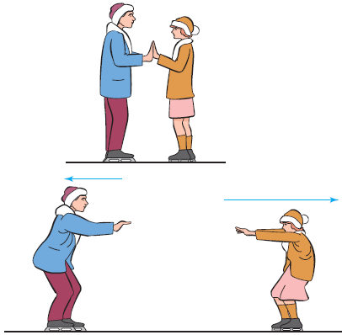
5. A 50-kg person (person L) and a 20-kg person (person R) are standing on slippery ice. The 50-kg person pushes the 20-kg person right with a force of 10 N.
(a) What is the magnitude and direction of the acceleration of the 20-kg person?

Slide 46
5. A 50-kg person (person L) and a 20-kg person (person R) are standing on slippery ice. The 50-kg person pushes the 20-kg person right with a force of 10 N.
(a) What is the magnitude and direction of the acceleration of the 20-kg person?
F_{net} = ma
a = $\frac{\text{F}\text{net}}{m}$ = $\frac{\text{10}\text{N}}{20kg}$
Acceleration is right (same direction as the force)

Slide 47
5. A 50-kg person (person L) and a 20-kg person (person R) are standing on slippery ice. The 50-kg person pushes the 20-kg person right with a force of 10 N.
(b) What is the magnitude and direction of the force the 50-kg person experiences?
Newton’s 3rd law of motion

Slide 48
5. A 50-kg person (person L) and a 20-kg person (person R) are standing on slippery ice. The 50-kg person pushes the 20-kg person right with a force of 10 N.
(b) What is the magnitude and direction of the force the 50-kg person experiences?
Newton’s 3rd law of motion
10 N to the left

Slide 49
5. A 50-kg person (person L) and a 20-kg person (person R) are standing on slippery ice. The 50-kg person pushes the 20-kg person right with a force of 10 N.
(c) What is the magnitude and direction of the acceleration of the 50-kg person?

Slide 50
5. A 50-kg person (person L) and a 20-kg person (person R) are standing on slippery ice. The 50-kg person pushes the 20-kg person right with a force of 10 N.
(c) What is the magnitude and direction of the acceleration of the 50-kg person?
F_{net} = ma
a = $\frac{\text{F}\text{net}}{m}$ = $\frac{\text{10}\text{N}}{50kg}$
Acceleration is left (same direction as the reaction force)

Slide 51
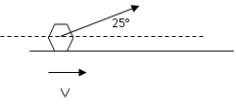
6. A 10-kg object is sliding across a rough surface. A force F of 50 N pulls on the object at an upward angle of 25º. The force pulls the object from rest to a speed of 10 m/s in 4 seconds.
(a) What is the X-component of the force?

Slide 52
6. A 10-kg object is sliding across a rough surface. A force F of 50 N pulls on the object at an upward angle of 25º. The force pulls the object from rest to a speed of 10 m/s in 4 seconds.
(a) What is the X-component of the force?
Cos Θ = $\frac{adj}{hyp.}$ = $\frac{x comp}{hyp.}$
X comp = (Cos Θ)(hyp)
= (cos 25°) (50N)

Slide 53
6. A 10-kg object is sliding across a rough surface. A force F of 50 N pulls on the object at an upward angle of 25º. The force pulls the object from rest to a speed of 10 m/s in 4 seconds.
(b) What is the Y-component of the force?

Slide 54
6. A 10-kg object is sliding across a rough surface. A force F of 50 N pulls on the object at an upward angle of 25º. The force pulls the object from rest to a speed of 10 m/s in 4 seconds.
(b) What is the Y-component of the force?
sin Θ = $\frac{opp}{hyp.}$ = $\frac{y comp}{hyp.}$
Y comp = (sin Θ)(hyp)
= (sin 25°) (50N)

Slide 55
6. A 10-kg object is sliding across a rough surface. A force F of 50 N pulls on the object at an upward angle of 25º. The force pulls the object from rest to a speed of 10 m/s in 4 seconds.
(c) What is the acceleration of the object?

Slide 56
6. A 10-kg object is sliding across a rough surface. A force F of 50 N pulls on the object at an upward angle of 25º. The force pulls the object from rest to a speed of 10 m/s in 4 seconds.
(c) What is the acceleration of the object?
V_{o} = 0 m/s
V_{f} = 10 m/s
t = 4 s

Slide 57
6. A 10-kg object is sliding across a rough surface. A force F of 50 N pulls on the object at an upward angle of 25º. The force pulls the object from rest to a speed of 10 m/s in 4 seconds.
(c) What is the acceleration of the object?
V_{o} = 0 m/s
V_{f} = 10 m/s
t = 4 s
V_{f} = V_{o} + at
a = $\frac{\text{V}\text{f}− \text{V}\text{o}−}{t}$ = $\frac{10−0 m/s}{4s}$

Slide 58
6. A 10-kg object is sliding across a rough surface. A force F of 50 N pulls on the object at an upward angle of 25º. The force pulls the object from rest to a speed of 10 m/s in 4 seconds.
(d) What is the magnitude and direction of the NET force
on the object?
m = 10 kg
a = 2.5 m/s²

Slide 59
6. A 10-kg object is sliding across a rough surface. A force F of 50 N pulls on the object at an upward angle of 25º. The force pulls the object from rest to a speed of 10 m/s in 4 seconds.
(d) What is the magnitude and direction of the NET force
on the object?
m = 10 kg
a = 2.5 m/s²
F_{net} = ma
= (10 kg)(2.5 m/s²)
(to the right)

Slide 60
6. A 10-kg object is sliding across a rough surface. A force F of 50 N pulls on the object at an upward angle of 25º. The force pulls the object from rest to a speed of 10 m/s in 4 seconds.
(e) What is the magnitude of the friction on the object?

Slide 61
6. A 10-kg object is sliding across a rough surface. A force F of 50 N pulls on the object at an upward angle of 25º. The force pulls the object from rest to a speed of 10 m/s in 4 seconds.
(e) What is the magnitude of the friction on the object?
F_{net} = F_{x-comp} + F_{f}

Slide 62
6. A 10-kg object is sliding across a rough surface. A force F of 50 N pulls on the object at an upward angle of 25º. The force pulls the object from rest to a speed of 10 m/s in 4 seconds.
(e) What is the magnitude of the friction on the object?
F_{net} = F_{x-comp} + F_{f}
25 N = 45.32 N + F_{f}
F_{f} = 25 N – 45.32 N

Slide 63
6. A 10-kg object is sliding across a rough surface. A force F of 50 N pulls on the object at an upward angle of 25º. The force pulls the object from rest to a speed of 10 m/s in 4 seconds.
(f) What is the magnitude of the normal force on the object?

Slide 64
6. A 10-kg object is sliding across a rough surface. A force F of 50 N pulls on the object at an upward angle of 25º. The force pulls the object from rest to a speed of 10 m/s in 4 seconds.
(f) What is the magnitude of the normal force on the object?

Slide 65
6. A 10-kg object is sliding across a rough surface. A force F of 50 N pulls on the object at an upward angle of 25º. The force pulls the object from rest to a speed of 10 m/s in 4 seconds.
(f) What is the magnitude of the normal force on the object?
F_{net} = F_{y-comp} + F_{N} + F_{w}
0 = F_{y-comp} + F_{N} + F_{w}
-F_{w} = F_{y-comp} + F_{N}
No upward or downward motion means the total Y component forces will equal zero

Slide 66
6. A 10-kg object is sliding across a rough surface. A force F of 50 N pulls on the object at an upward angle of 25º. The force pulls the object from rest to a speed of 10 m/s in 4 seconds.
(f) What is the magnitude of the normal force on the object?
0 = F_{y-comp} + F_{N} + F_{w}
0 = F_{y-comp} + F_{N} + F_{W}
0 = 21.13 N + F_{N} + -(10 kg)(-9.8 m/s²)
98 N -21.13 N = F_{N}
F_{N} = 98 N – 21.13 N

Slide 67
7. A person holds a 10-kg object on a 37º inclined, frictionless ramp.
(a) What is the weight of the object?
37°

Slide 68
7. A person holds a 10-kg object on a 37º inclined, frictionless ramp.
F_{w} = mg = (10 kg)(-9.8 m/s²)
(a) What is the weight of the object?
37°

Slide 69
7. A person holds a 10-kg object on a 37º inclined, frictionless ramp.
(b) What is the magnitude and direction of the person’s force?
37°

Slide 70
7. A person holds a 10-kg object on a 37º inclined, frictionless ramp.
(b) What is the magnitude and direction of the person’s force?
0 = F_{c} + F_{w} _{(x-comp)}
-F_{w} _{(x-comp)} = F_{c}
37°

Slide 71
7. A person holds a 10-kg object on a 37º inclined, frictionless ramp.
(b) What is the magnitude and direction of the person’s force?
-F_{w} x-comp = F_{c}
sin Θ = $\frac{opp}{hyp.}$ = $\frac{x comp}{−98 N}$-
- (sin 37°)(-98 N) = Fc
37°

Slide 72
7. A person holds a 10-kg object on a 37º inclined, frictionless ramp. The object is released and the object slides down the ramp.
(c) What is the NET force on the object while the object slides down the ramp?
37°

Slide 73
7. A person holds a 10-kg object on a 37º inclined, frictionless ramp. The object is released and the object slides down the ramp.
(c) What is the NET force on the object while the object slides down the ramp?
F_{w} x-comp
sin Θ = $\frac{opp}{hyp.}$ = $\frac{x comp}{−98 N}$-
(sin 37°)(-98 N) =
(same as before, except without opposing force)
37°

Slide 74
7. A person holds a 10-kg object on a 37º inclined, frictionless ramp. The object is released and the object slides down the ramp.
(d) What is the acceleration of the object while the object slides down the ramp?
37°

Slide 75
7. A person holds a 10-kg object on a 37º inclined, frictionless ramp. The object is released and the object slides down the ramp.
(d) What is the acceleration of the object while the object slides down the ramp?
Fnet = ma
59 N= (10 kg) a
a = $\frac{59 N}{10 kg}$
37°

Slide 76
8. Object A has a mass of 20 kg and object B has a mass of 5 kg. The objects are held motionless.
(a) What is the tension in the connecting rope?

Slide 77
8. Object A has a mass of 20 kg and object B has a mass of 5 kg. The objects are held motionless.
(a) What is the tension in the connecting rope?
If motionless, the F_{w} of object B = F_{t}
F_{w} = mg = (5 kg)(-9.8 m/s²)

Slide 78
8. Object A has a mass of 20 kg and object B has a mass of 5 kg. When released, object A moves a distance of 9 meters in 3 seconds. .
(b) What is the acceleration of object A?

Slide 79
8. Object A has a mass of 20 kg and object B has a mass of 5 kg. When released, object A moves a distance of 9 meters in 3 seconds. .
(b) What is the acceleration of object A?
V_{avg} = $\frac{Δx}{Δt}$ = $\frac{9m}{3s}$
V_{avg} = $\frac{Vo+Vf}{2}$
3 m/s = $\frac{0+Vf}{2}$
Vf= 6 m/s

Slide 80
8. Object A has a mass of 20 kg and object B has a mass of 5 kg. When released, object A moves a distance of 9 meters in 3 seconds. .
(b) What is the acceleration of object A?
V_{f}= 6 m/s
V_{f} = V_{o} + at
6 m/s = 0 + a (3s)
a = 2 m/s²

Slide 81
8. Object A has a mass of 20 kg and object B has a mass of 5 kg. When released, object A moves a distance of 9 meters in 3 seconds. .
(c) What is the acceleration of object B?

Slide 82
8. Object A has a mass of 20 kg and object B has a mass of 5 kg. When released, object A moves a distance of 9 meters in 3 seconds. .
(c) What is the acceleration of object B?
a = -2 m/s²
Object B and A accelerate at the same rate (In downward direction).

Slide 83
8. Object A has a mass of 20 kg and object B has a mass of 5 kg. When released, object A moves a distance of 9 meters in 3 seconds. .
(d) What is the NET force on object A?

Slide 84
8. Object A has a mass of 20 kg and object B has a mass of 5 kg. When released, object A moves a distance of 9 meters in 3 seconds. .
(d) What is the NET force on object A?
Fnet = ma
= (20 kg)(2m/s²)
To the right

Slide 85
8. Object A has a mass of 20 kg and object B has a mass of 5 kg. When released, object A moves a distance of 9 meters in 3 seconds. .
(e) What is the NET force on object B?

Slide 86
8. Object A has a mass of 20 kg and object B has a mass of 5 kg. When released, object A moves a distance of 9 meters in 3 seconds. .
(e) What is the NET force on object B?
Fnet = ma
= (5 kg)(-2m/s²)
downward

Slide 87
8. Object A has a mass of 20 kg and object B has a mass of 5 kg. When released, object A moves a distance of 9 meters in 3 seconds. .
(f) What is the tension in the connecting rope while object A moves?

Slide 88
8. Object A has a mass of 20 kg and object B has a mass of 5 kg. When released, object A moves a distance of 9 meters in 3 seconds. .
(f) What is the tension in the connecting rope while object A moves?
We do not have enough information to solve tension for object A based on what we need for object A
F_{net} = F_{t} + F_{f}
40 N = ? + ?

Slide 89
8. Object A has a mass of 20 kg and object B has a mass of 5 kg. When released, object A moves a distance of 9 meters in 3 seconds. .
(f) What is the tension in the connecting rope while object A moves?
However, we do know that the tension force is the same on object A as it is for object B.
So, we can solve for the tension in object B and it will be the same tension on object A.

Slide 90
8. Object A has a mass of 20 kg and object B has a mass of 5 kg. When released, object A moves a distance of 9 meters in 3 seconds. .
(f) What is the tension in the connecting rope while object A moves?
F_{net B} = F_{w B} + F_{t B}
-10 N = (5 kg * -9.8 m/s²) + Ft
Ft = -10 N + 49 N

