Slide 1
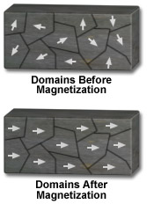
Magnetism occurs when domains “line up” with an external magnetic field

Slide 2
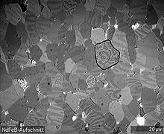
Magnetic domains within crystals The dark lines are the domains.

Slide 3
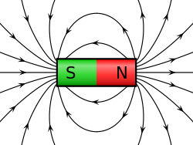
Magnetic field around a bar magnet nonuniform field

Slide 4
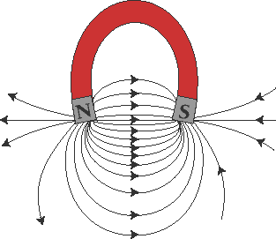
Magnetic field around horseshoe magnet

Slide 5
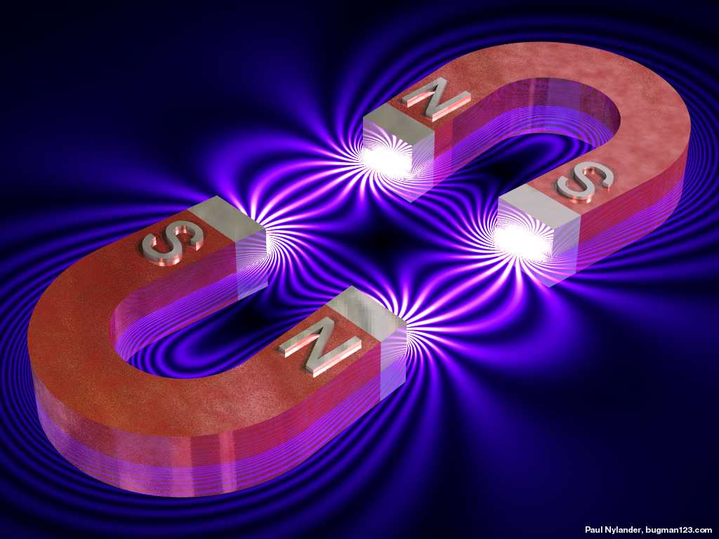
Magnetic field between opposite poles

Slide 6
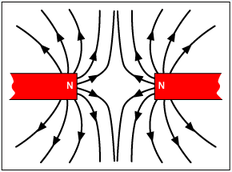
Magnetic field between like poles

Slide 7
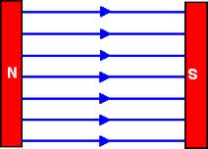
Uniform magnetic field between opposite poles

Slide 8
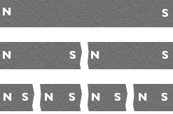
Breaking a magnet produces two new magnets each with two poles

Slide 9
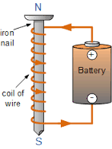
Electromagnet

Slide 10
Electromagnet

Slide 11
Right Hand Rule
The right had Rule can be used do figure out which direction the magnetic field is moving in based on the direction of the current moving through the wire.

Slide 12
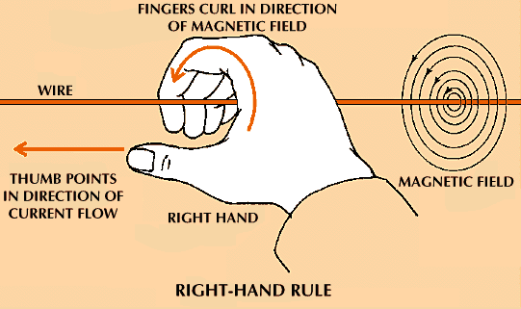
Right Hand Rule

Slide 13
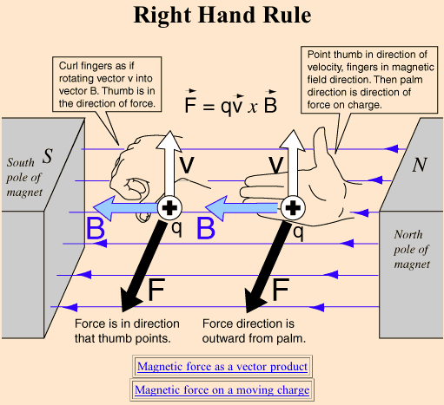
Right Hand Rule

Slide 14
Transformer
The iron core of a transformer is normally a complete ring with two coils wound on it. One is connected to a source of electrical power and is called the 'primary coil'; the other supplies the power to a load and is called the 'secondary coil'. The magnetization due to the current in the primary coil runs all the way round the ring.
The primary and secondary coils can be wound anywhere on the ring, because the iron carries the changes in magnetization from one coil to the other. There is no electrical connection between the two coils. However they are connected by the magnetic field in the iron core.

Slide 15
Transformer
When there is a steady current in the primary there is no effect in the secondary, but there is an effect in the secondary if the current in the primary is changing. A changing current in the primary induces an e.m.f. in the secondary. If the secondary is connected to a circuit then there is a current flow.
A step-down transformer of 1,200 turns on the primary coil connected to 240 V a.c. will produce 2 V a.c. across a 10-turn secondary (provided the energy losses are minimal) and so light a 2 V lamp. A step-up transformer with 1,000 turns on the primary fed by 200 V a.c. and a 10,000-turn secondary will give a voltage of 2,000 V a.c.

Slide 16
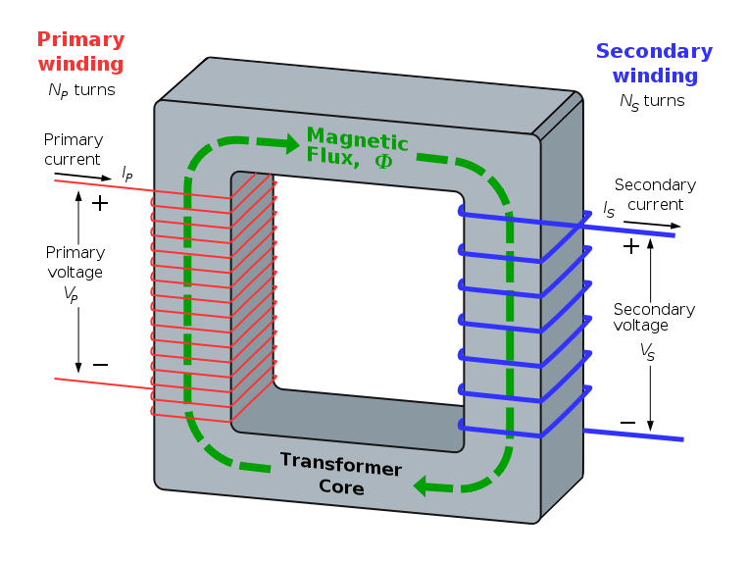
Step down transformer

Slide 17
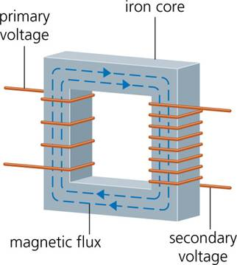
Step up transformer

Slide 18
Transformers
Number of turns is directly proportional to Voltage and inversely proportional to Current.

