Slide 1
What is the Atomic Theory?
Atomic Theory – Matter is made up of fundamental particles.

Slide 2
What do YOU know about the atom?
Draw a picture of the atom and label it with as much detail as you can.

Slide 3
Early Thoughts
Scientists were aware that matter is made up of small particles.
But originally, they thought the atom was “indivisible”! (Basically just little spheres that could not be broken down.)
Now – We know the atom is made up of smaller particles (subatomic particles).

Slide 4
Rutherford’s Gold Foil Experiment

Slide 6
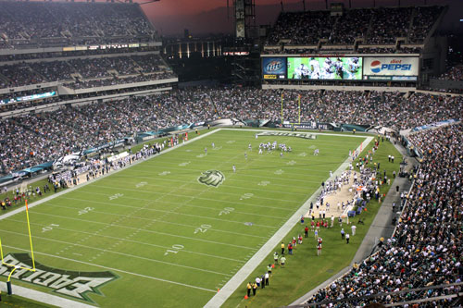
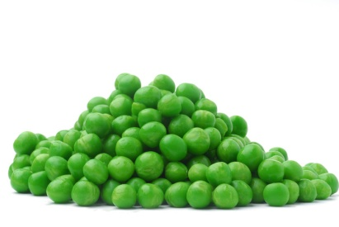
To better understand how significant Rutherford’s work was…
If an atom was the size of a football field, the nucleus would be the size of a green pea on the 50 yard line.

Slide 7
The craziest part…
ALL the mass of the entire atom is only in that little, tiny nucleus!!!!
Why?
Electrons weigh pretty much NOTHING!!!

Slide 8
Here’s what you need to remember:
When Rutherford shot alpha particles at gold foil:
Most of the alpha particles went straight through the foil… → Atoms are mostly empty space.
A few bounced back… → Small, dense positively-charged nucleus.
Nucleus: small, dense core containing protons and neutrons.
Electrons surround the nucleus.

Slide 9
Subatomic Particles
Particle | Symbol | Relative Charge | Relative Mass | Location in atom
Proton | p⁺ | 1+ | 1 | nucleus
Neutron | nº | 0 | 1 | nucleus
Electron | e⁻ | 1- | 1/2000 ~ 0 | outside nucleus
Notice that only neutrons and protons have mass!

Slide 10
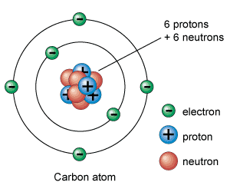
Parts of an atom – DRAW IT!
Nucleus

Slide 11
The NUCLEUS
Located at the center of the atom.
Takes up ALL the mass of atom.
Contains protons (+) and neutrons (0).
Electrons surround it.

Slide 13
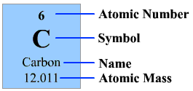
Atomic Number – “Z”
# of protons
THIS IDENTIFIES THE ELEMENT!!!
What makes carbon a carbon atom? 6 protons!
What happens if you take away a proton from carbon? It becomes boron!! (5 protons)
The atomic numbers are on the periodic table.

Slide 14
Neutral Atoms
In a neutral atom, # of protons = # of electrons
Why does it make sense that p+ and e- would be equal if the atom is neutral?
The (+) charges from the protons would have to balance the (-) charges from the electrons.

Slide 15
Ions
Ion: formed when an atom gains or loses an ELECTRON and becomes charged.
Note: Opposite of what you think!!
Gained an electron → (-) charge
Lost an electron → (+) charge

Slide 16
Ions (cont’d)
1+
Examples: Na → lost 1 electron
S → gained 2 electrons
To find # of electrons, start with # of protons and do opposite what the charge says.
Practice: Find the number of e- for each:
1) Ca 2) F 3) Na 4) P
2-
2+
1-
1+
3-

Slide 17
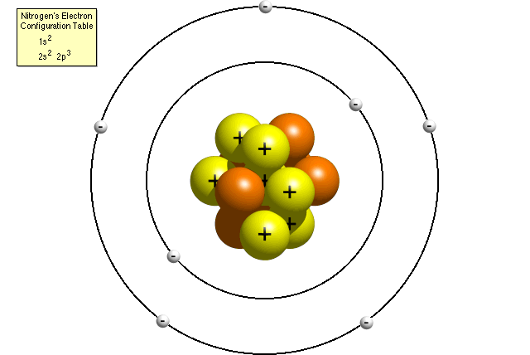
Mass Number – “A”
Mass = (# of protons) + (# of neutrons)
Most of the mass of the atom is concentrated in the nucleus. (Electrons don’t really weigh anything.)
Notes:
17

Slide 18
Isotope Symbol
Mass Number
(#P + #N)
9
Be
4
Atomic Number
(#P)

Slide 19
To find the number of neutrons in an atom…
# neutrons = (mass number) – (atomic number)
Notes:
19

Slide 20
How many protons and neutrons are found in the nucleus of these atoms?
Na
S
Ag
Pb
Carbon-14
Fluorine-19
Chromium-52
23
11
32
16
108
47
207
82
Notes:
20

Slide 21
How many protons and neutrons are found in the nucleus of these atoms?
p = 11 n = 12
P = 16 n = 16
P = 47 n = 61
P = 82 n = 125
P = 6 n = 8
P = 9 n = 10
P = 24 n = 28
Na
S
Ag
Pb
Carbon-14
Fluorine-19
Chromium-52
23
11
32
16
108
47
207
82
Notes:
21

Slide 22
Mass # and The Periodic Table
Note – If you are not given a mass number, you can round the atomic mass on the periodic table to the nearest whole number…

Slide 23
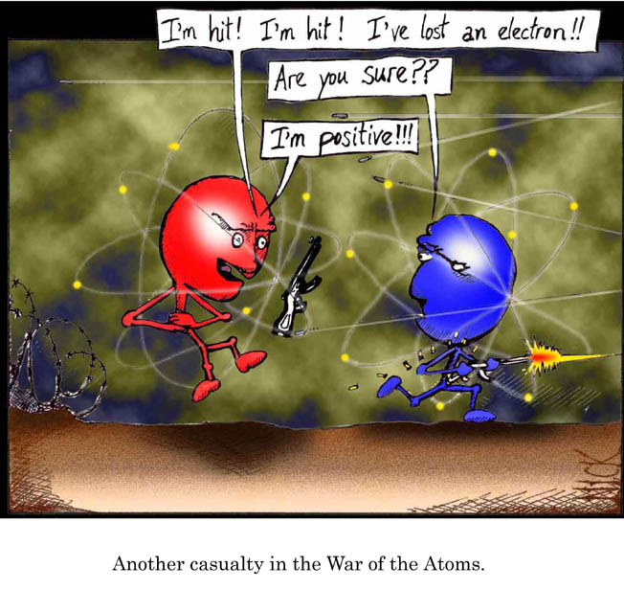

Slide 24
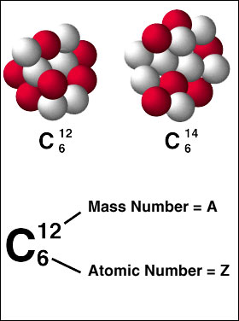
Isotopes
Isotopes – atoms that have the same # protons, but different # neutrons.
Different mass numbers b/c different # neutrons.
Ex. carbon-12, carbon-14
* Both have 6 p⁺
* One has 6 n⁰ and
the other has 8 n⁰
Notes:
24

Slide 25
Isotope Examples
Example: How many protons, neutrons, & electrons? Ne-20: ___ p+, ____ e-, ____nº Ne-21: ___ p+, ____ e-, ____nº Ne-22: ___ p+, ____ e-, ____nº
Notes:
25

Slide 26
Isotope Examples
Example: How many protons, neutrons, & electrons? Ne-20: _10__ p+, _10___ e-, _10__nº Ne-21: _10__ p+, _10__ e-, _11__nº Ne-22: _10__ p+, _10___ e-, _12__nº

Slide 27
Average Atomic Mass
Average atomic mass – the average of all the naturally occurring isotopes of that element.
These are listed on the periodic table.
Units: grams/mole

Slide 28
Difference btwn Average Atomic Mass and Mass Number
Average Atomic Mass
Average of all the isotopes in the world
Long decimal
Found on Per. Tble.
Units are grams/mole
Mass Number
Mass of just 1 atom
Whole number
Either given to you or
you can round the
avg. atomic mass
on the per. tble.
Units are grams/mole

Slide 29
“Average Atomic Mass” vs. “Mass Number”
On the periodic table, the average atomic mass of lithium is 6.941 g/mol.
If I tell you I have a lithium atom with a mass of 8 g/mol, is that possible?

Slide 30
Average Atomic Mass from Relative Abundance
To calculate average from relative abundance:
Multiply the percent (in decimal form) by each mass.
Add all masses together.
Example: Calculate the average atomic mass of the following sample of carbon: 98.892% carbon-12
1.108% carbon-13
(0.98892 x 12) + (0.0108 x 13) = 12.011 amu

Slide 31
Average Atomic Mass Example
Calculate the average atomic mass of the following sample: 90.51% neon-20
0.27% neon-21
9.22% neon-22
(0.9051 x 20) + (0.0027 x 21) + (0.0922 x 22)
= 20.18 amu

Slide 32
Preview to the Periodic Table
Organized by increasing atomic number.
Period = horizontal row
Group or Family = vertical column
(Helpful Hint – Think of a “family tree”…and trees grow up/down.)
Notes:
32

Slide 33
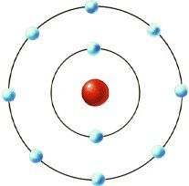
Bohr’s Planetary Model, 1913
Electrons move in circular paths (orbits) around the positive nucleus.
Planetary model - Like planets around a sun

Slide 34
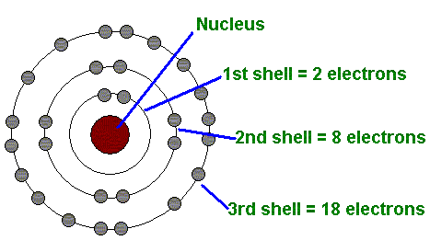
Bohr used experiments on hydrogen to develop this model:
1) An electron circles the nucleus only in fixed energy levels (like an orbit).
2) An electron can neither gain nor lose energy within the orbit…but it can move up or down to different orbits.
3) The lowest energy orbit is closets to the nucleus.

Slide 35
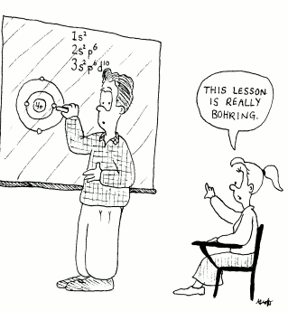

Slide 36
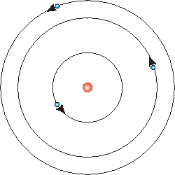
Energy Levels
Energy Levels - Regions of space in which e- can move around the nucleus of an atom.
“Rings around the nucleus where e- exist.”
Ground State – closest possible E.L. to the nucleus.
Excited State – If given a quantum (packet of energy), e- can move to a higher E.L. (farther from nucleus). This state is unstable!

Slide 37
Bohr’s Model
* Think of it like a
circular ladder.
* It takes energy to
climb up the ladder
(away from the nucleus)
* The higher you go, the
more energy it takes &
the more unstable it is.
* Notice the rings get
closer together as you
move out…

Slide 38
How an Emission Spectrum is Produced
1) An e- starts in ground state.
2) It can gain energy and move to an excited state.
3) But then it is unstable, so it returns to ground state…and in the process, gives off the energy it received. → Emission Spectrum

Slide 39
Emission Spectra
When an electron moves to a lower energy level, it releases an amount of energy equal to the energy difference in these levels as electromagnetic radiation - Emission Spectrum
This electromagnetic radiation is given off as
photons - quanta or packets of light

Slide 40
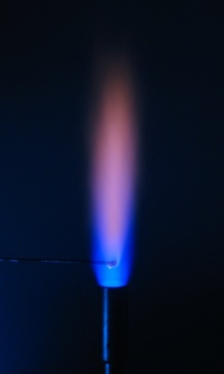
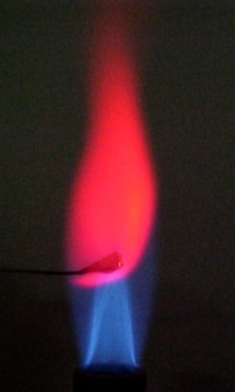
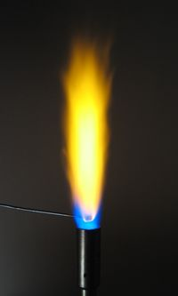
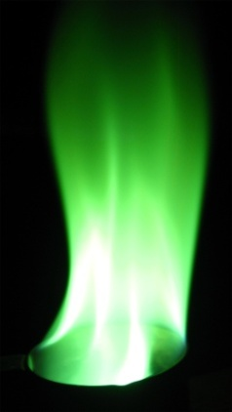
Emission Spectra
No 2 elements have the same emission spectrum (because they each have a unique set of e-).
The farther the electron falls, the greater the amount of energy released.

Slide 41
The Real World
What is a real world application of giving electrons energy and then having them return to ground state?

Slide 42
Using the Reference Table
How much energy is released when an electron moves from the 3rd energy level to the 1st? What type of radiation is it?
What color light is released when an electron moves from the 4th energy level to the 2nd?
What wavelength could be given off if you see red light?

Slide 43
Electromagnetic Spectrum
Electromagnetic radiation → energy waves that have both electrical and magnetic properties.
Can travel through empty space at
c = 3 x 10⁸ m/s (the speed of light).

Slide 44
Wave/Particle duality of electrons
Which one is it? BOTH
Electrons act like a particle
But they behave like waves!!

Slide 45
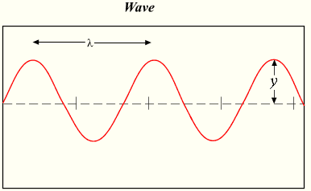
Wavelength, Frequency, Energy
Wavelength (λ) – distance from peak to peak.
Frequency – number of peaks per second.
Crest – Top peak of the wave.
Trough – Bottom of the wave.
crest
Wavelenth
trough

Slide 46
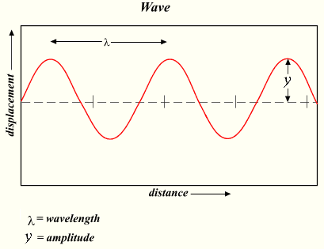
Relationships
wavelength – frequency → Indirectly related
wavelength – energy → Indirectly related
frequency – energy → Directly related

Slide 47
Electromagnetic Spectrum
Low Energy, Low Frequency, Long Wavelength
1. Radio Waves (AM, FM, TV)
2. Microwaves (cell phones, microwave ovens)
3. Infrared (given off as heat)
4. Visible Light (ROYGBIV: Red is the lowest energy,
violet has the highest)
5. Ultraviolet (causes sunburns)
6. X-rays (can pass through body, except bones)
7. Gamma Rays (can pass through 3 meters of
concrete)
High Energy, High Frequency, Short Wavelength

Slide 48
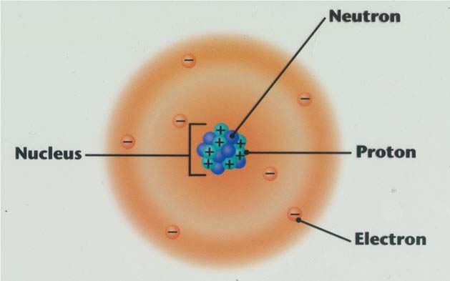
Quantum Model
Schrodinger
Cannot pinpoint the exact paths of electrons (only probability!!!).
Probability of finding an electron is represented by an electron cloud.

Slide 49
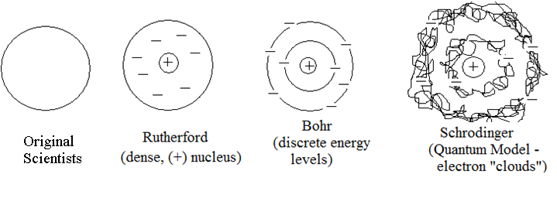
Overall Progression of the Atom

Slide 50
Quantum Numbers
Quantum Numbers - Values that give the most probable place to find an electron.
Like an “electron’s address”.
No 2 electrons in an atom can have the same quantum numbers.

Slide 51
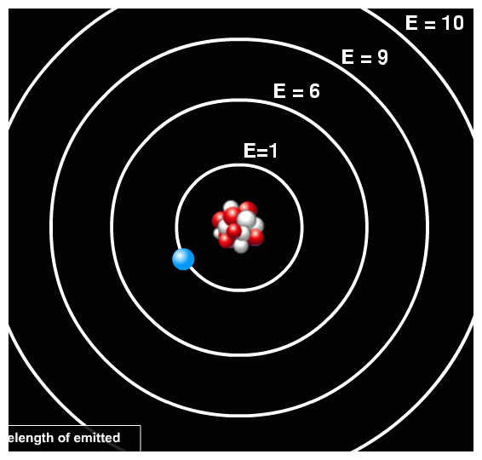
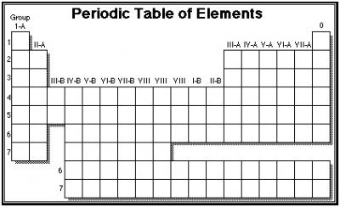
First Quantum Number
Energy Levels – cloud SIZE
(Rings around the nucleus)
Corresponds to horizontal rows on the periodic table.

Slide 52
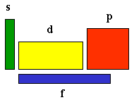
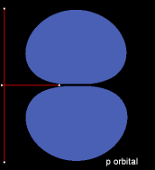
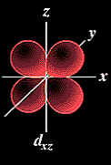
Second Quantum Number
Sublevels – SHAPE
There are four:
s (sphere)
p (peanut)
d (double peanut)
f (?)
- They correspond to areas of the periodic table.
Energy level tells the number of sublevels.
Ex. In the 1st energy level, you can have 1 sublevel → s
In the 2nd energy level, you can have 2 sublevels → s & p

Slide 53
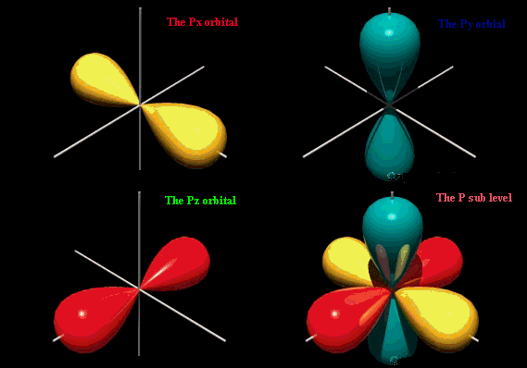
Third Quantum Number
Orbitals – DIRECTION (Orientation)
Two electrons can fit in one orbital.
s p d f
# orbitals
# electrons
1
3
5
7
2
6
10
14

Slide 54
Fourth Quantum Number
Spin
2 electrons in the same orbital MUST have opposite spins.
Based on Pauli’s Exclusion Principle

Slide 55
Quantum Number Practice
Energy Level | Number of Sublevels | Sublevel Names | Number of Electrons per Sublevel |  |  |  | Max # of Electrons per Energy Level
 |  |  | s | p | d | f
1
2
3
4

Slide 56
Quantum Numbers Practice
Energy Level | Number of Sublevels | Sublevel Names | Number of Electrons per Sublevel |  |  |  | Max # of Electrons per Energy Level
 |  |  | s | p | d | f
1 | 1 | s | 2 |  |  |  | 2
2 | 2 | s,p | 2 | 6 |  |  | 8
3 | 3 | s,p,d | 2 | 6 | 10 |  | 18
4 | 4 | s,p,d,f | 2 | 6 | 10 | 14 | 32

Slide 57
Electron Configuration
Electron Configuration – The most stable arrangement of electrons in sublevels and orbitals.

Slide 58
3 Things about e- Configurations
Aufbau Principle – “Building up”
Electrons occupy the lowest energy level available.
Pauli’s Exclusion Principle – “Different addresses”
If 2 electrons are in the same orbital, they HAVE to have opposite spins.
Hund’s Rule – “Fair share”
Each orbital in a sublevel MUST have 1 electron before any orbital in that sublevel receives a 2nd.

Slide 59
Format of e- Configurations
Oxygen: 1s²2s²2p⁴
“Exponents” tell how many electrons are in that region of space
Coefficients tell the energy level (distance from the nucleus
Letters tell the sublevel (shape) of the orbital

Slide 60
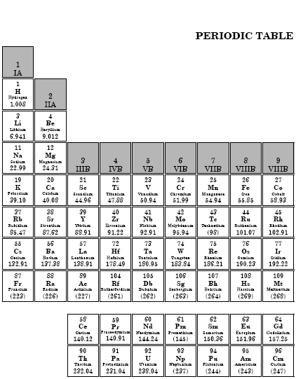
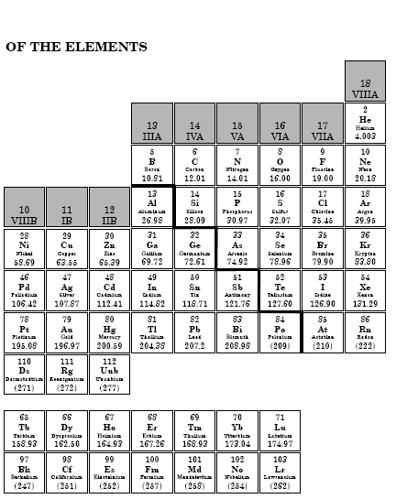

Slide 61
Practice: Writing e- Configurations
Carbon –
Argon –
Fluorine –
Germanium –
Potassium –
1s²2s²2p²
1s²2s²2p⁶3s²3p⁶
1s²2s²2p⁵
1s²2s²2p⁶3s²3p⁶4s²3d¹⁰4p²
1s²2s²2p⁶3s²3p⁶4s¹

Slide 62
Abbreviated Electron Configuration
Helium 1s²
Lithium [He]2s¹
Carbon [He]2s²2p²
Neon [He]2s²2p⁶ = [Ne]
Sodium [Ne]3s¹
Scandium [Ar]4s²3d¹

Slide 63
Practice w/ Abbreviated e- Config.
Calcium
Selenium
Strontium
Magnesium
Cobalt
Americium
Lead
[Ar]4s²
[Ar]4s²3d¹⁰4p⁴
[Kr]5s²
[Ne]3s²
[Ar]4s²3d⁷
[Rn]7s²5f⁶
[Xe]6s²4f¹⁴5d¹⁰6p²

Slide 64
Electron Configurations of Ions
If you are given an ion (w/ a charge), first write the e- config. for the neutral atom.
Then add (if -) or take away (if +) e- as needed. Note: remove e- from the highest orbital (biggest coefficient) first!
Ex. Write the electron configuration for S²⁻.
First – 1s²2s²2p⁶3s²3p⁴
Then think about the charge: 2- means you need to
add 2 more electrons.
They can be put in the 3 p orbital (b/c it can hold up to 6 e-).
1s²2s²2p⁶3s²3p⁶

Slide 65
Practice: e- configurations of ions
Write the electron configuration for each:
(You can abbreviate.)
Mg²⁺
Cl⁻
Ni⁺
O²⁻
[Ne] 2s²2p⁶
[Ne] 3s²3p⁶
[Ar] 4s¹3d⁸
[He] 2s²2p⁶

Slide 66
Orbital Notation
Use boxes and arrows to show electron configurations.
Don’t forget “opposite spins” and “fair share” rules!
Example: Sulfur [Ne]3s²3p⁴
3s²
3p⁴

Slide 67
Practice with Orbital Notation
First write the abbreviated e- configuration for each. Then draw the orbital notations.
1) Si
2) As
3) Sr
[Ne]3s²3p²
[Ar]4s²3d¹⁰4p³
[Kr]5s²

Slide 68
Valence Electrons
Valence Electrons – electrons in the outermost energy level
Determines the chemical and physical properties of elements!!
Use the periodic table to figure out the number of valence e-.
Exception – All noble gases have 8 valence electrons EXCEPT helium, which has 2.
“D” and “F” block elements have 2 valence electrons

Slide 69
Practice with Valence e-
Determine the # of valence e- for each:
Silicon
Bromine
Aluminum
Antimony (Sb)
Cesium

